Slide 1

PROJECT 1
Interpret Data Visualizations
Author: Saksham Taneja

Slide 2
Summary
The project has a purpose to show 3 insights finding the the chosen dashboard.
Linkedin Dashboard link here
This Dashboard hows top skills on Linkedin in 2016
The dashboard shows skills as per global rank and country wise

Slide 3
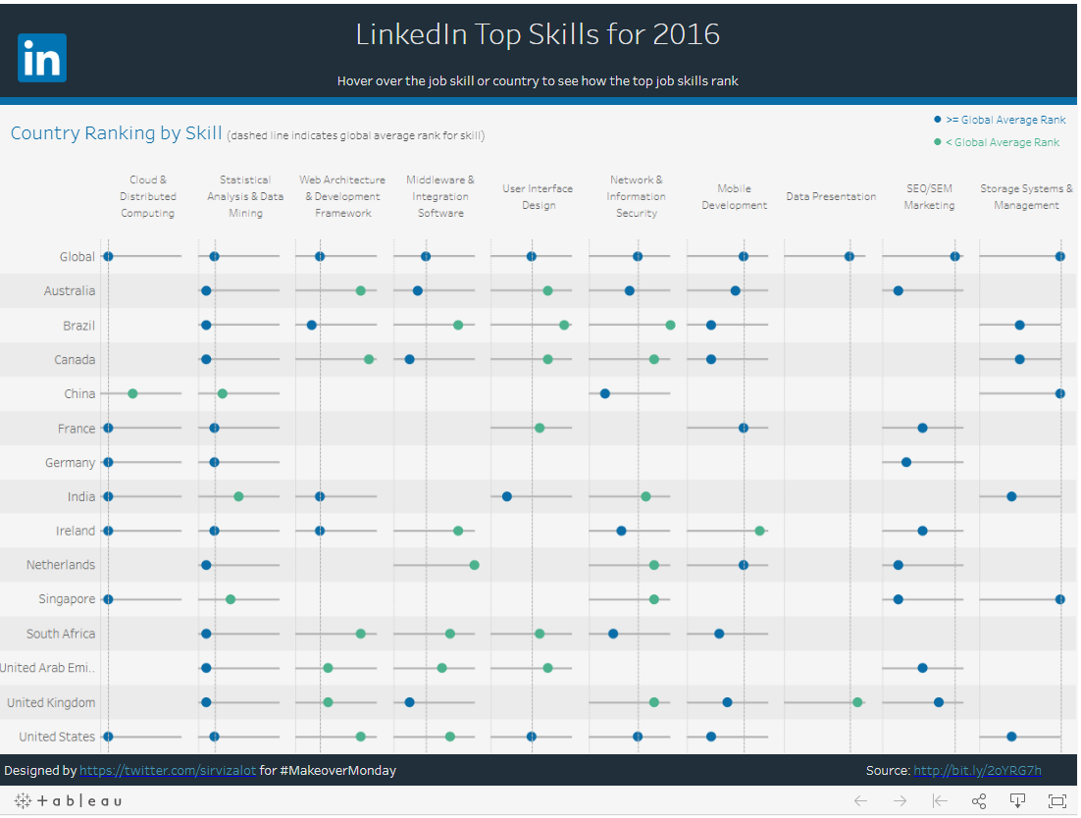
Overview of Dashboard

Slide 4

3 Insights

Slide 5

INSIGHT 1
Top Linkedin Skills for 2016 in India!
When analyzing the data of linkedin top skills in INDIA I see that except some skills which are present in global rank all other skills are there in India ranking as well which is a good stats.
In majority 6 skills are demanding in india and 4 are not as per the Data
Cloud and Distributed computing is on top in india as per the number as well as having rank #1
Review based on >= global avg rank and green numbers mean < global avg rank

Slide 6
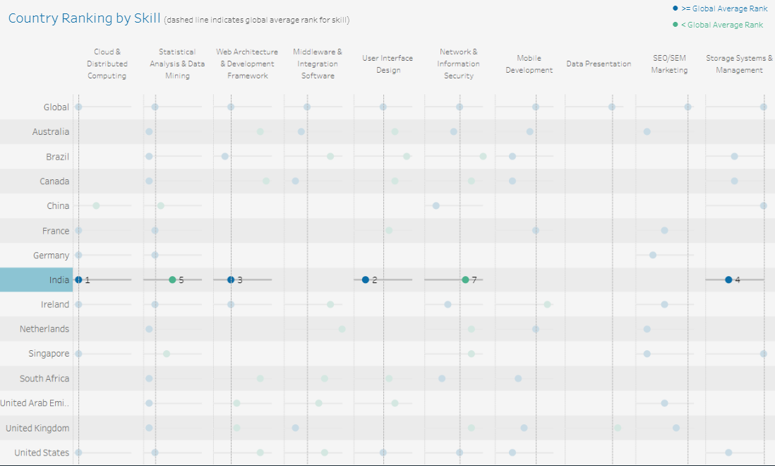

Slide 7
INSIGHT 2
Top Trending skill around the world
Statistical analytics and Data Mining is on the top where every country hold some position
In the global rank its on second but every country contributes in this skills
I can say that it is most demanding skill and worth to learn as a career as well
Ts on global ranking 2

Slide 8
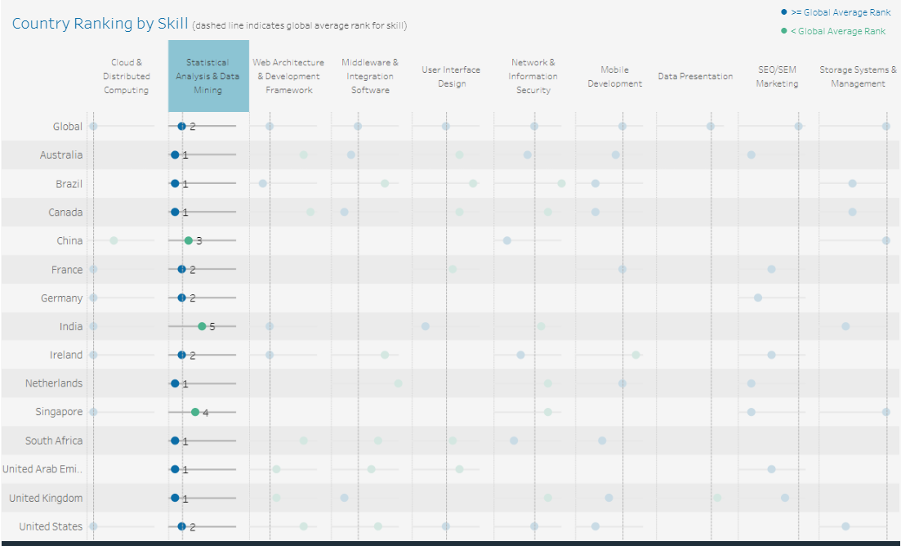

Slide 9
INSIGHT 3
Less Skilled People in World
I see Data presentation on #8 is less skilled as only one country participating in this skill
It has global ranking #8 and only United Kingdom is participation with this skills
As per my analysis country should start learning this skills as we might get need of this skills and then we don’t need to outsource it

Slide 10
